Slide 1


Investors Pitch
and Profit Improvement

Slide 2

Agenda
1
1
Investors Pitch
2
2
Profit Improvement
3
3
Recommendations

Slide 3
Why Invest?!
Books
Toys
Clothes
Shoes
Food
Furniture
Household items
$61,544
$92,943
2015
2016
2017
2018
$54,092
$81,377

Slide 4
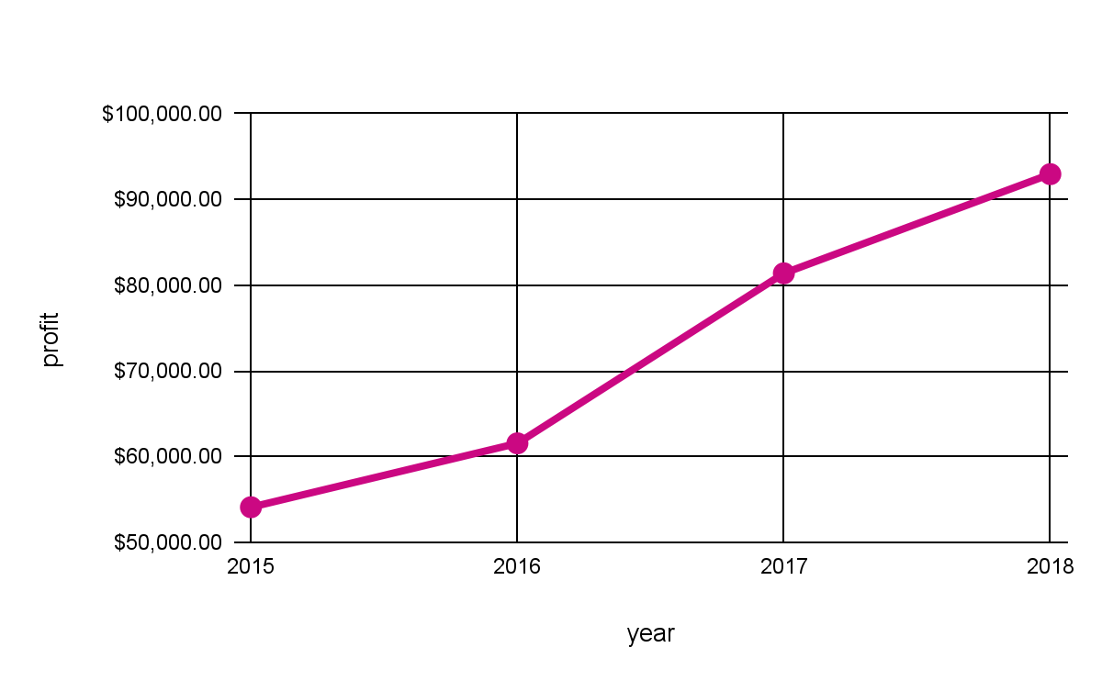
So…?
Top 5 categories:
1.Copiers - $55618
2.Phones - $44492
3.Accessories - $43240
4.Paper - $34147
5.Binders - $30234

Slide 5
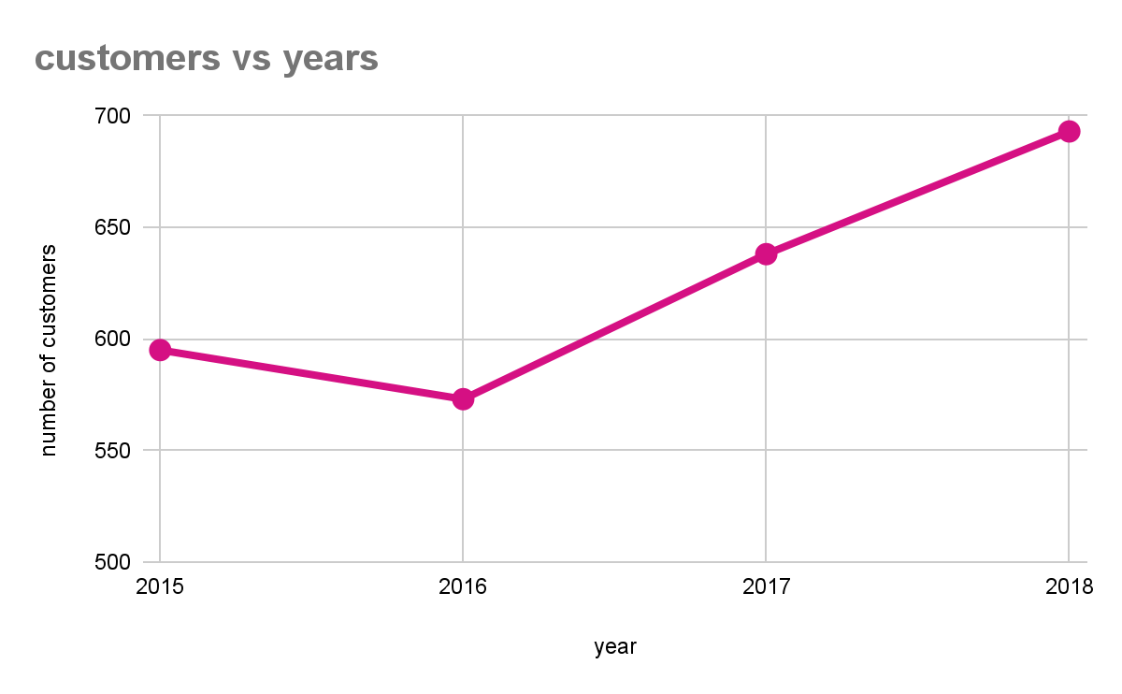
Interesting…
New York city
Top cities
New York City - $66556
Los Angeles - $30439
Seattle - $29144
San Francisco - $17494
Detroit - $13178

Slide 6
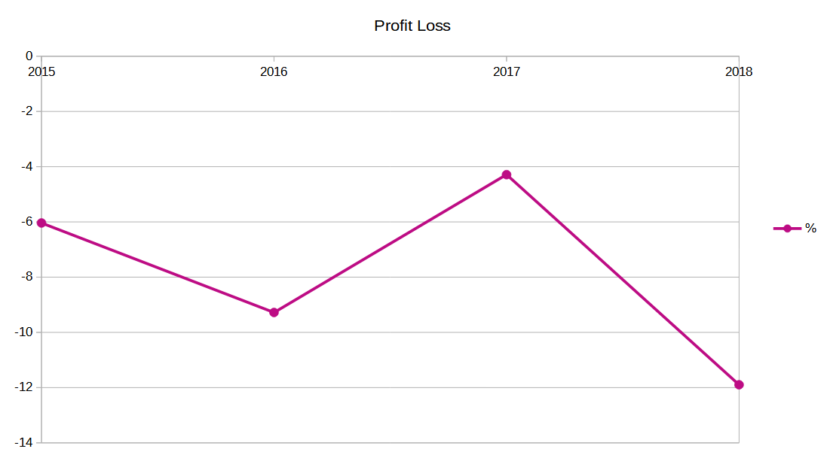
Profit improvement
New York city
Over the years we see that Unicorn has to fight with a yearly minimum 6% Profit loss (most caused by tables), only exception in 2017.
There are two factors which can be improved:
Categories
Customers

Slide 7
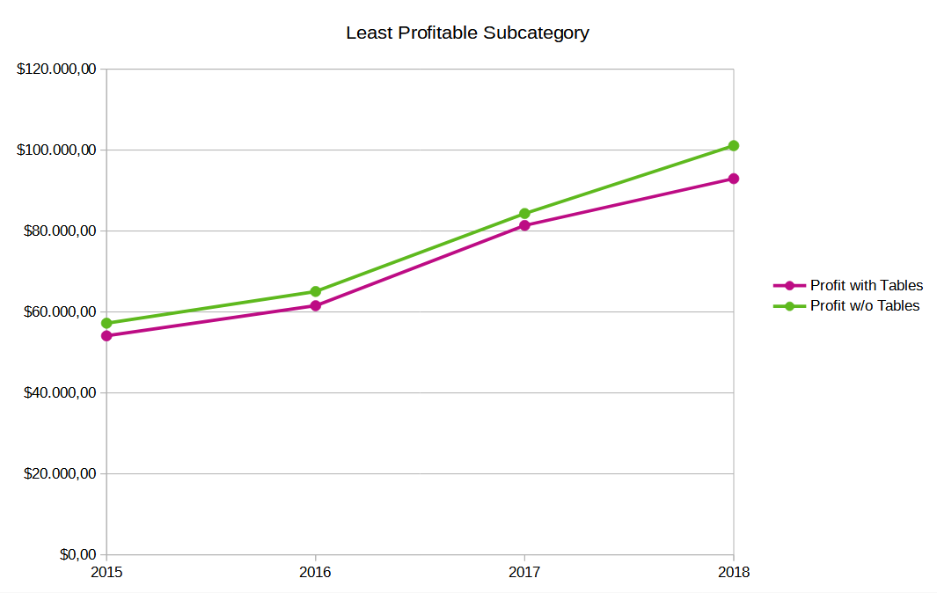
Category improvement
New York city
If Unicorn would remove Tables from the offer, the Profit would increase, since Tables is only causing a negative profit

Slide 8
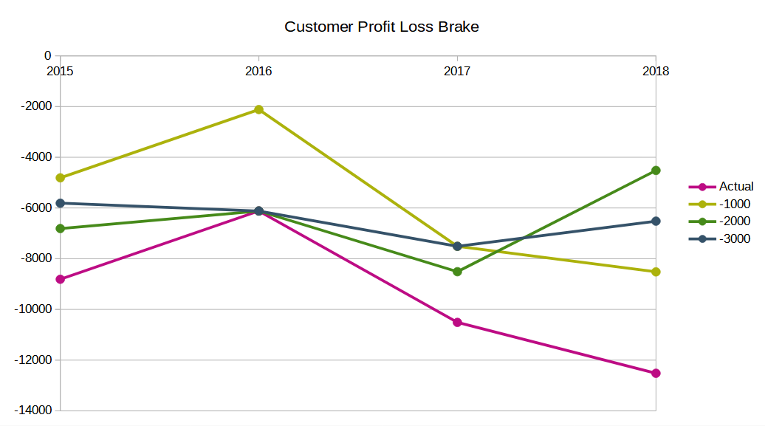
Customer improvement
New York city
If Unicorn would stop making business with customers who are least profitable, Profit would also improve. A “Customer Profit Loss Brake“ installed at $1000, $2000 or $3000 would have already a positive effect.

Slide 9
Recommendations
Get more customers
Attractive offers in holiday seasons
Increase warehouses in top cities
Increase top selling products like variety of phones
Decrease warehouses in last cities
Decrease last selling products
Affiliation stores
Last cities
Philadelphia - -$13832
Houston - -$10147
San Antonio - -$7300
Lancaster- -$7236
Chicago - -$6651
Last products
Tables - -$17733
Bookcases - -$3479
Supplies - -$1187
Fasteners - $1130
Machines - $3387

Slide 10
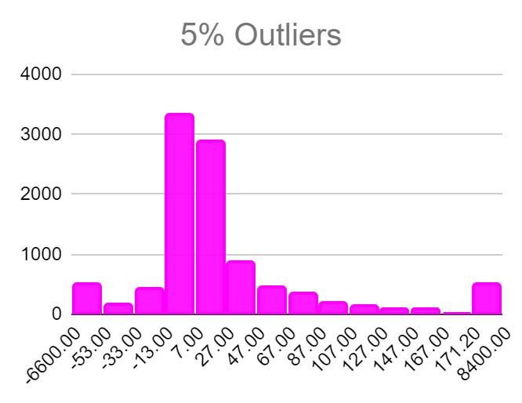
Data Approach
Exploratory data analysis to understand and summarize the dataset.
Data cleaning difficulties due to unusual date format in the dataset
Outliers in profit histogram

Slide 11

Team & Efforts
DA Team
Amulya Kandukuri
Jonathan Engisch
Marek Franke
Phebe Oluwaseun Femi-Ola
Efforts
Data cleaning using SQL
Getting insights through Tableau
Discussing derivations
Processing using Excel

